Slide 1


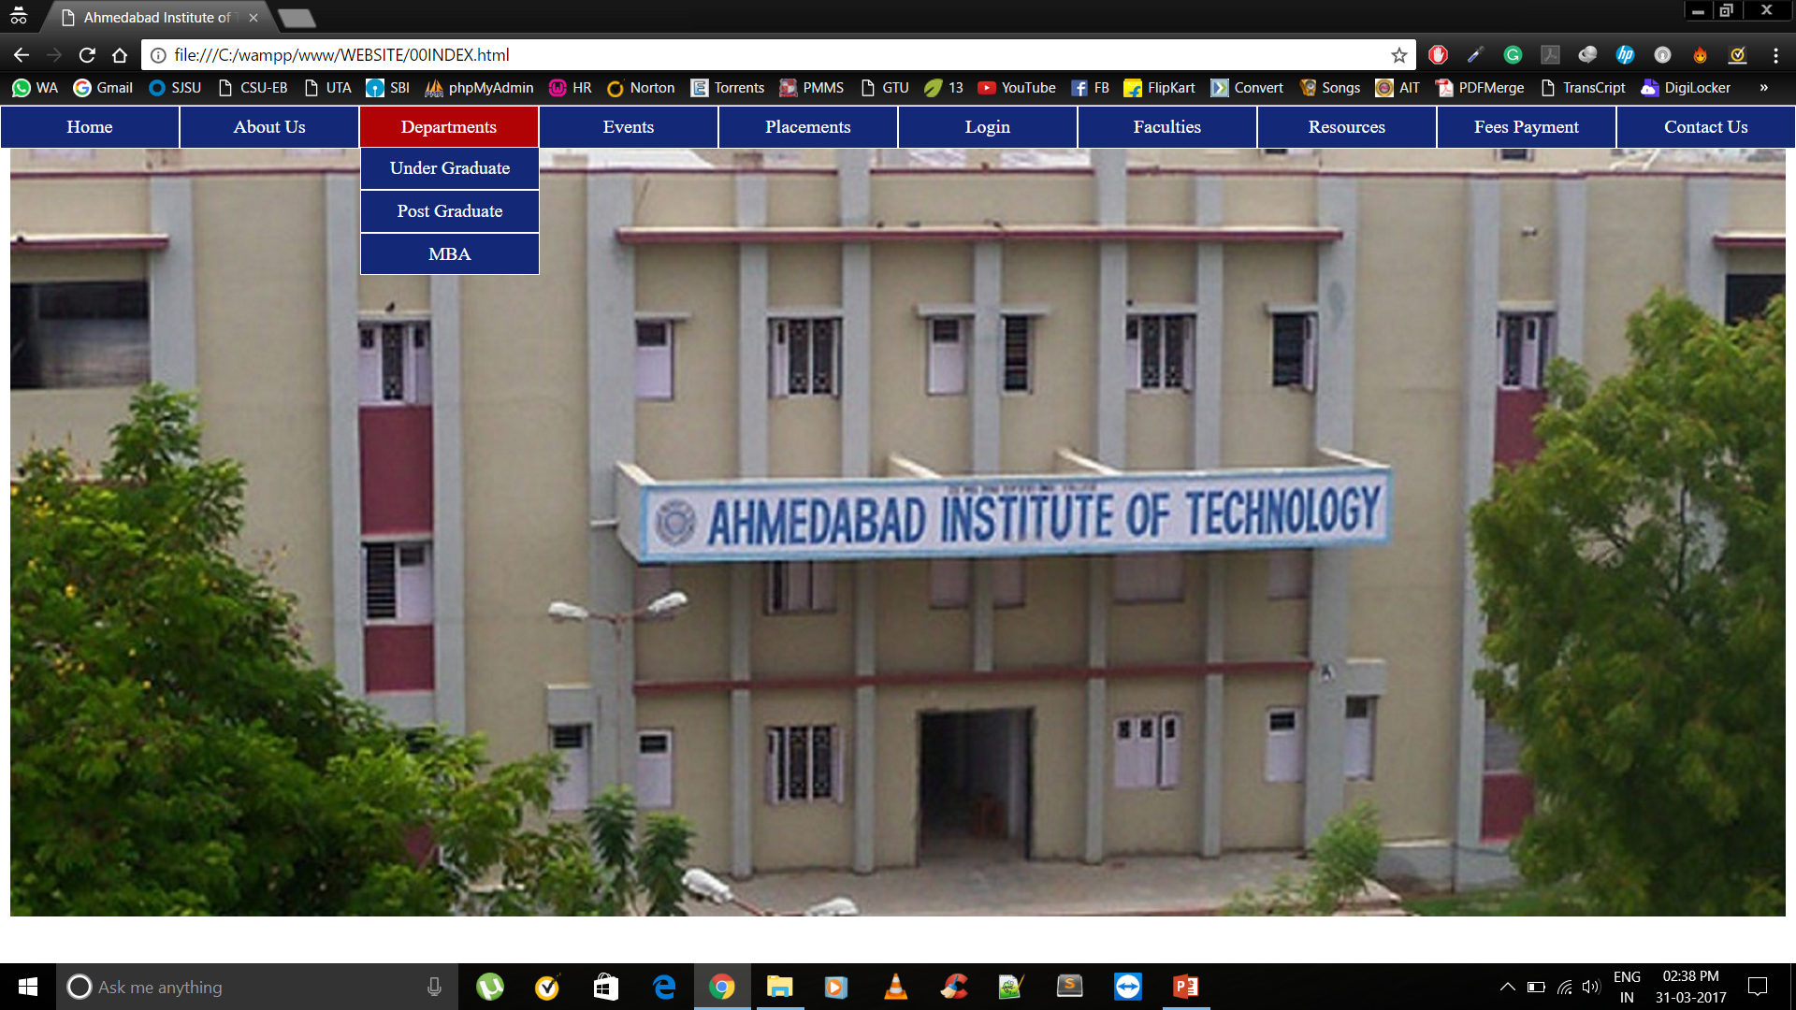
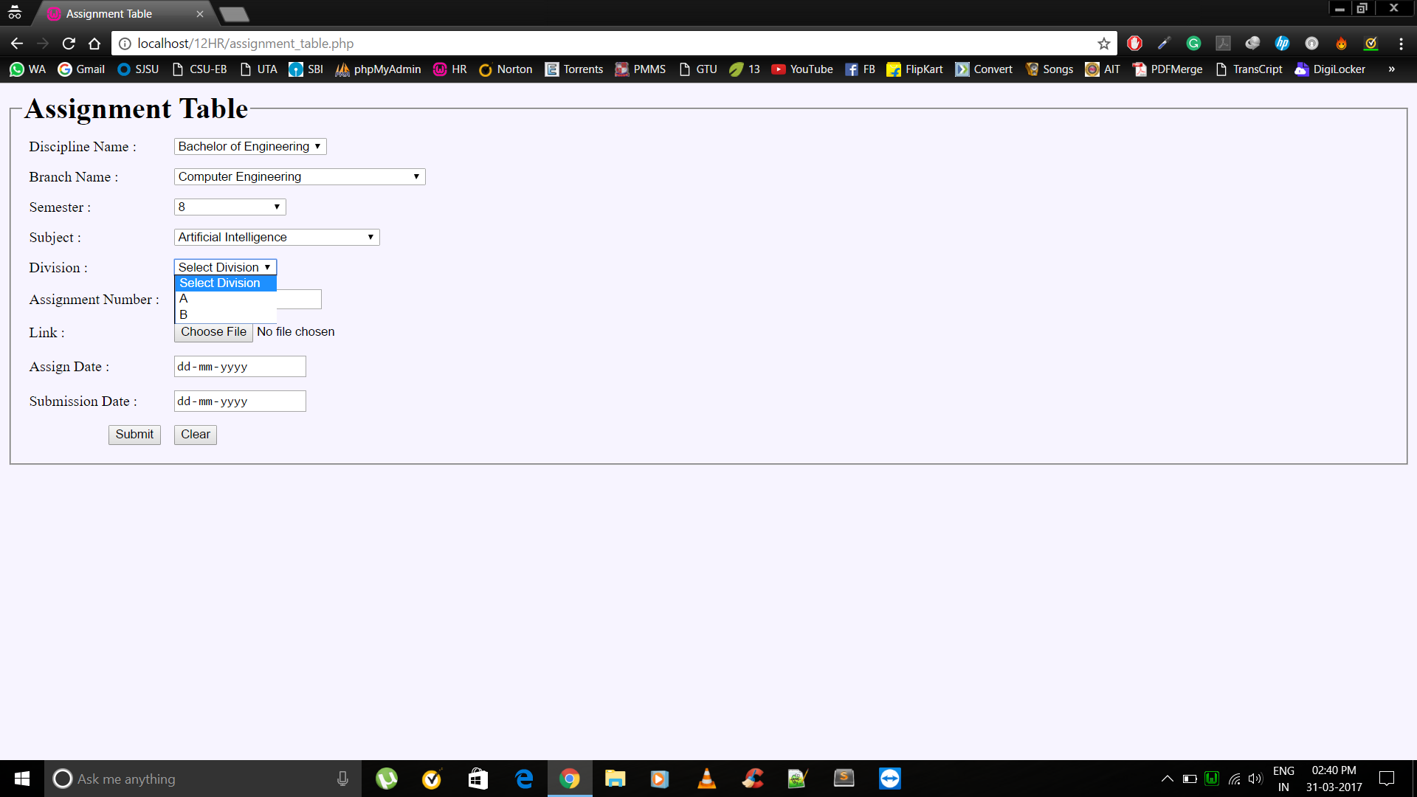
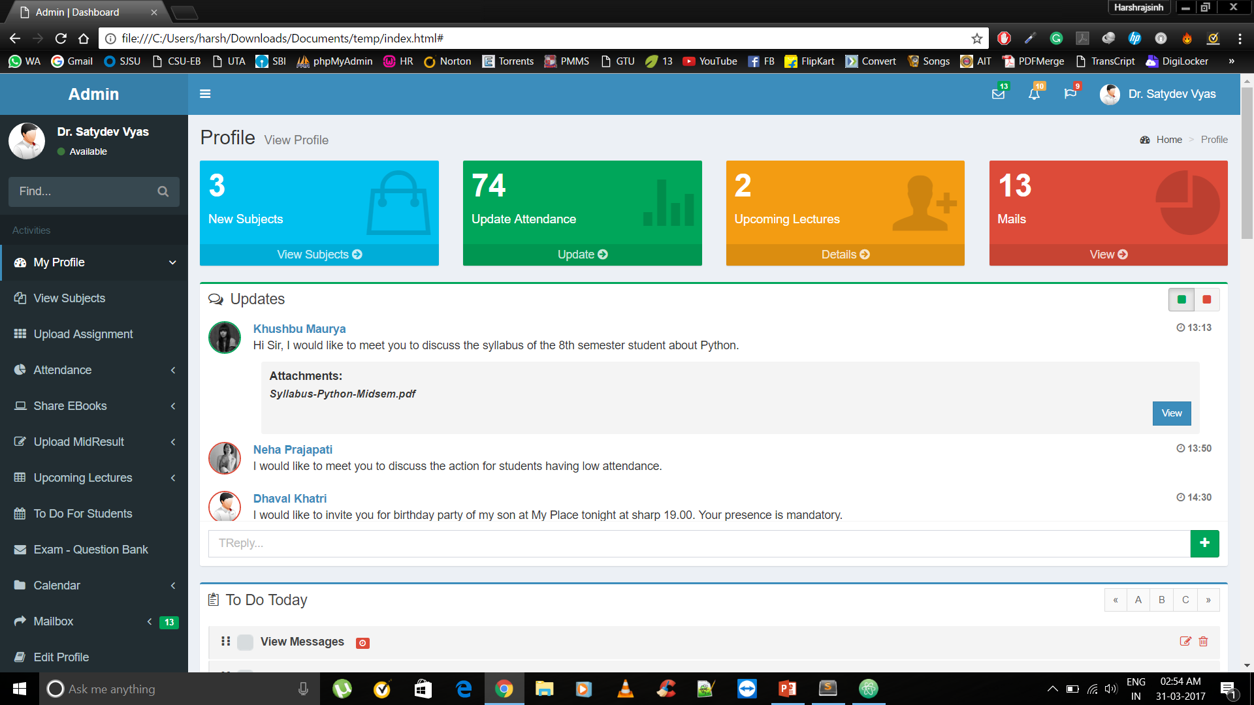
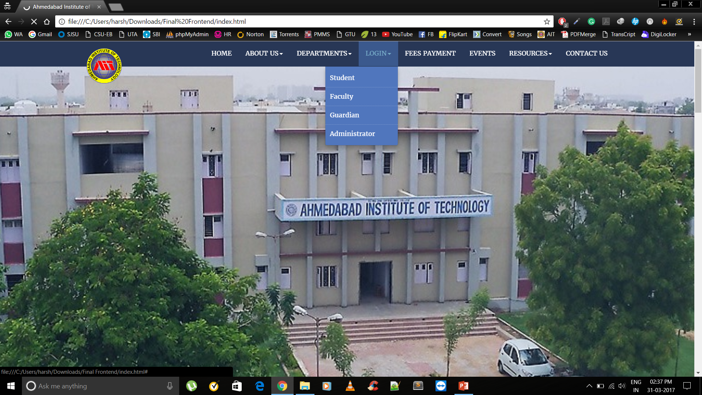
ERP PRODUCT FOR AIT AS SAAS AND BACKEND DESIGN
Prepared By: 130020107026-Darshit S Jasani
130020107065-Miloni S Patel
130020107086-Harshrajsinh V Rathod
Guided By : Prof. Dr. Satyadev Vyas
Computer Engineering, Ahmedabad Institute of Technology
INTRODUCTION
LIMITATIONS
The basic idea is to create a Website as SaaS which provides all the latest features which are unavailable in the existing one.
It will be a useful medium between faculties , hods , admin – staff , guardians and students.
Good internet connectivity required.
User must be authenticated to use the data.
User must be familiar with English language and computer technology as well.
SCOPE
FUTURE ENHANCEMENT
Core information available with reduced numbers of clicks.
Compatibility across bowsers.
Better co-ordination between all the four modules.
Minimal Paper work.
Available Library and stationary Books Record.
Pay Canteen Bill Through Online Wallet
Forums
Student Placement activity
Alumni records and job details
Meetup activity.
CONCLUSION
Explore possibilities of effective and positive relationship between connected modules.
Easy to take Attendance of students.
Helpful for Management and faculty and admin team.
Any authenticated user can get desired data.

